Slide 1
Analysis of Parking Tickets in
Washington, DC
Katie Salaris
Meron Desta
Miriam Brown
Robert Simon
Garett Taffey

Slide 2
Research Question & Data

Slide 3

Questions and Motivation
Questions:
Where do parking violations occur in the District?
When do parking violations occur in the District?
What are some general trends concerning parking violations in the District?
Can we predict how much money the DC government can collect in 2019?
Is parking in different areas of the District enforced disproportionately?

Slide 4
Data Sources
OpenData.DC.gov
CSV files of violations by month included every violation within that month
Data points included:
Time
Date
Location
Violation Code/Description
State Plate
Analysis covered all data from 2018 and month over month data for March, June, September and December from 2014-2018

Slide 5
Data Cleanup
Imports:
Pandas, Gmaps, Glob, os, numpy, matplotlib.pyplot, datetime, dateutil
Initial Steps:
Imported CSV files in a loop
Created a dataframe with 1,366,116 violations that combined the 12 files
Dropped unnecessary columns (mostly with NaN)
Converted date and time stamps from ISO 8601 format to separate columns with year, month, hour and minute

Slide 6
Analysis

Slide 7
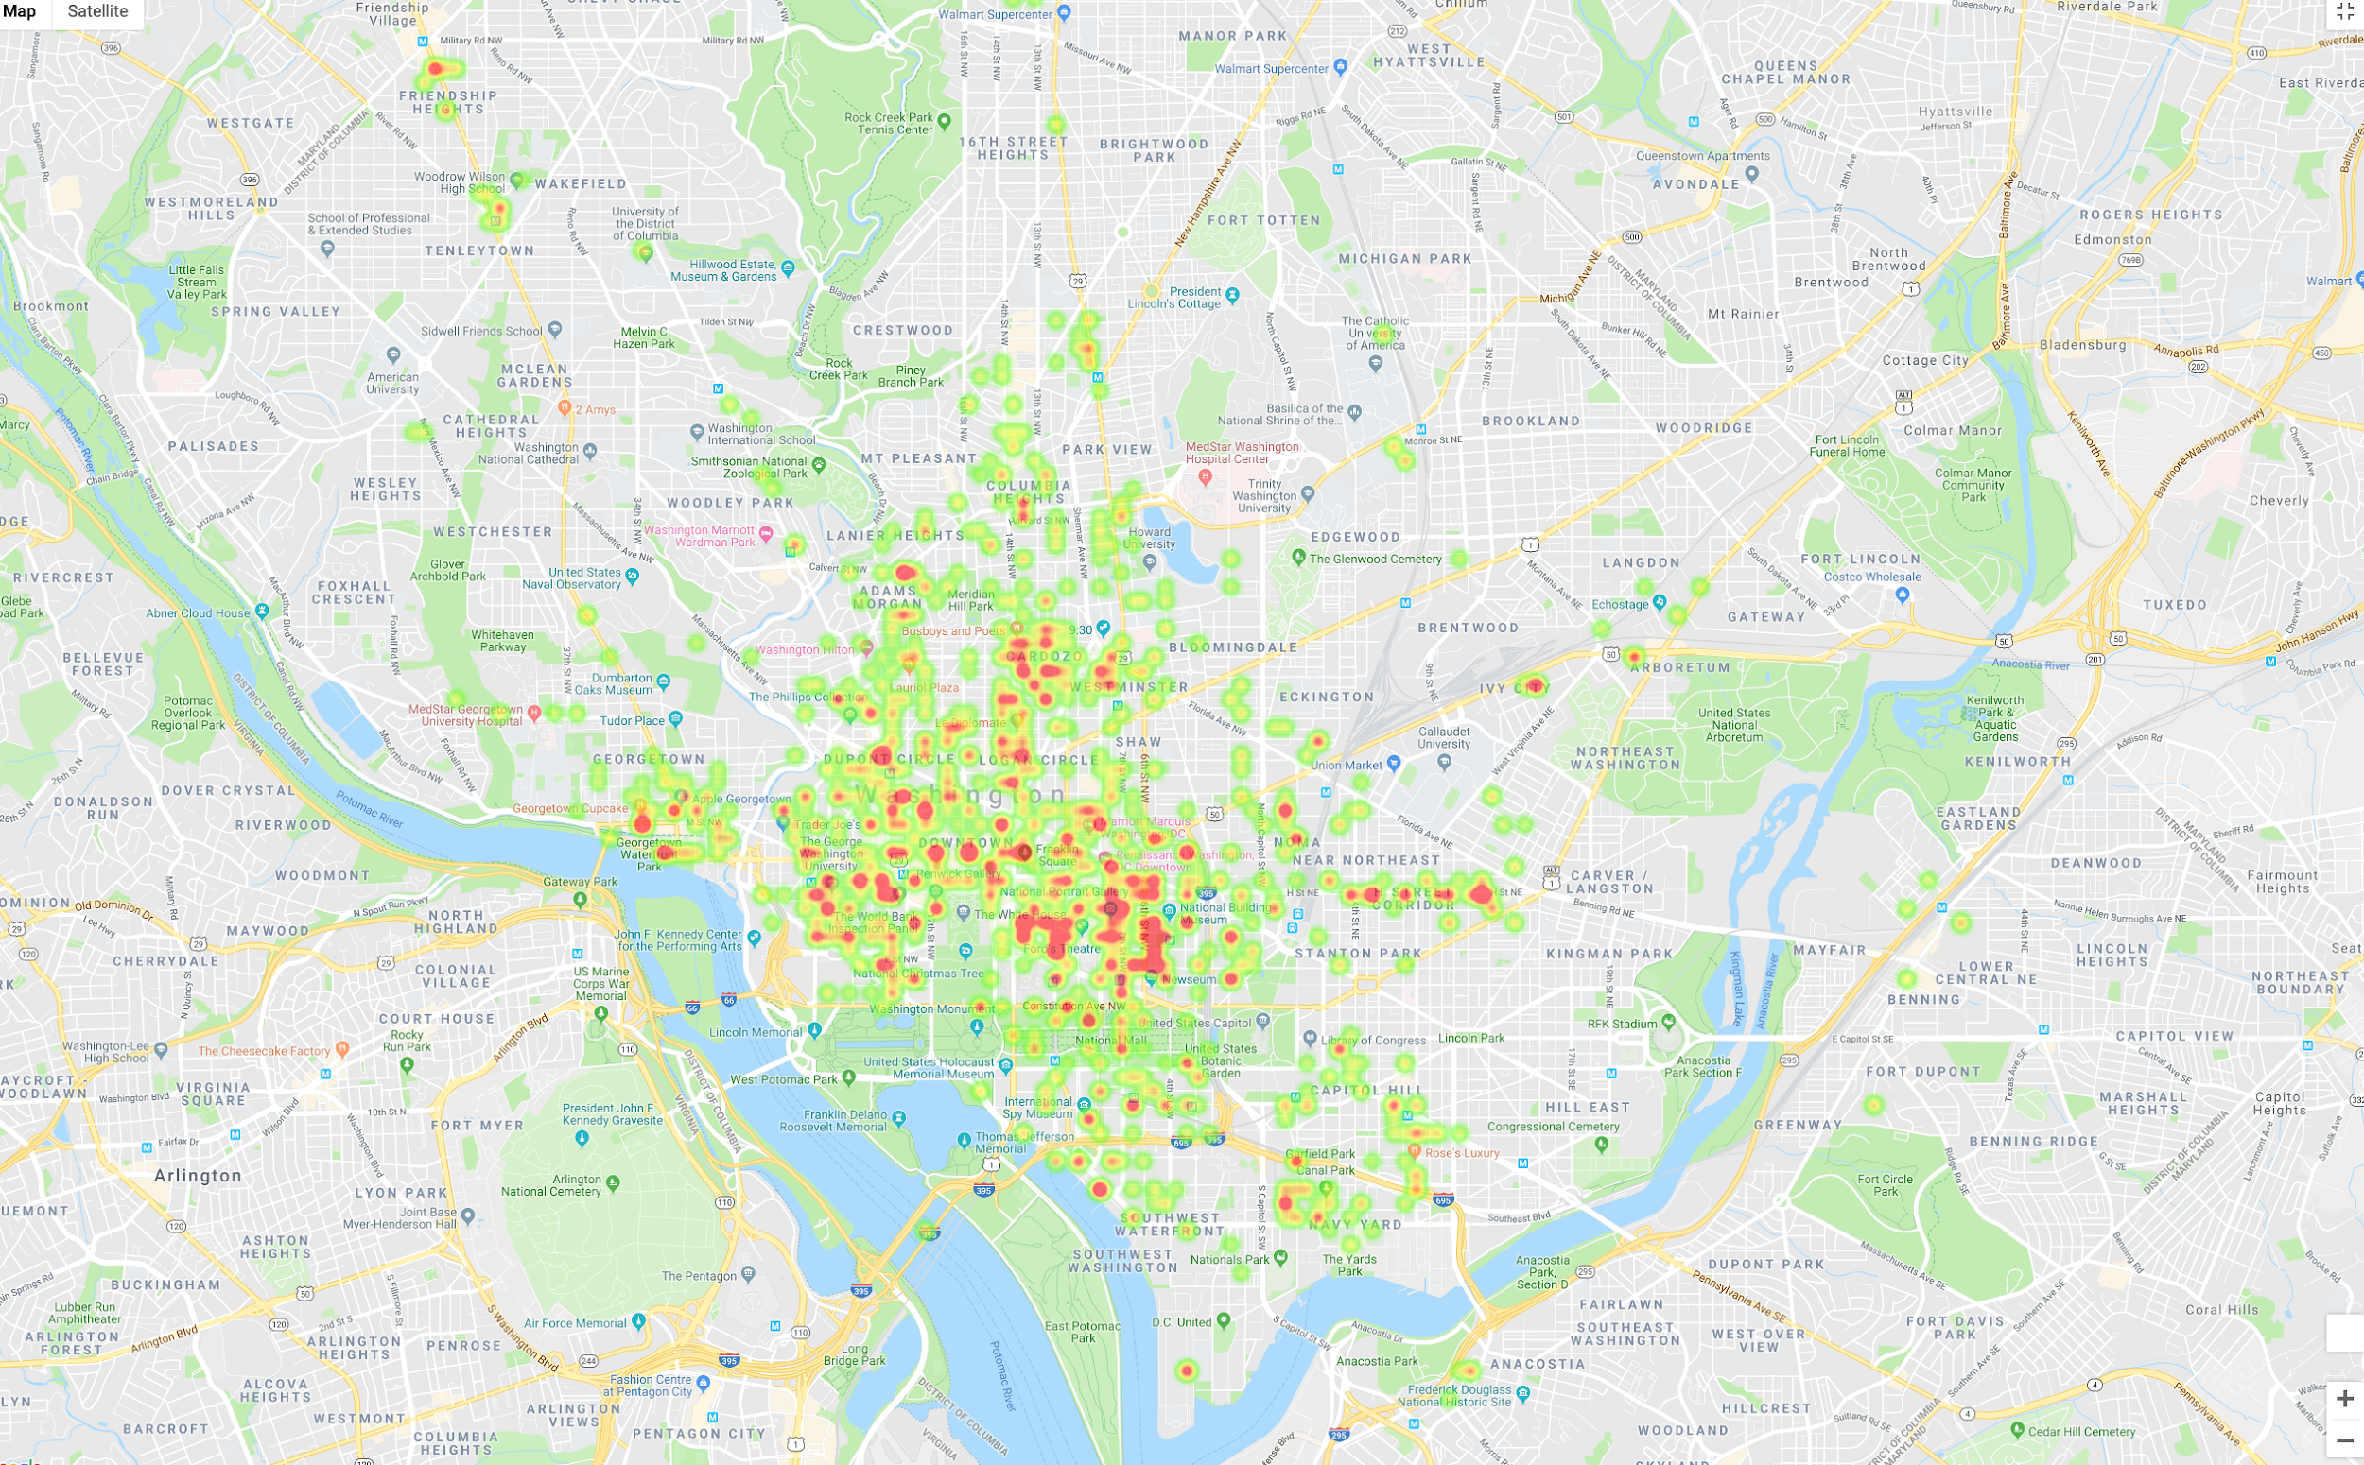
2018 Heat Map

Slide 8
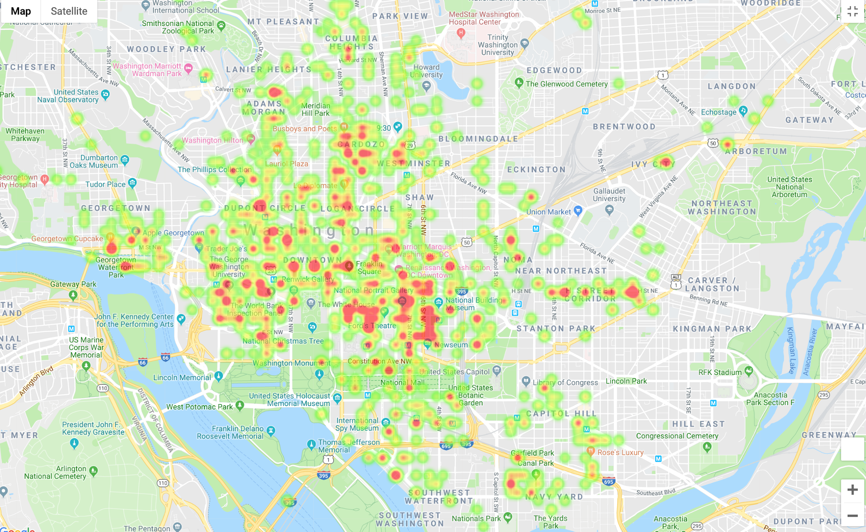

Slide 9
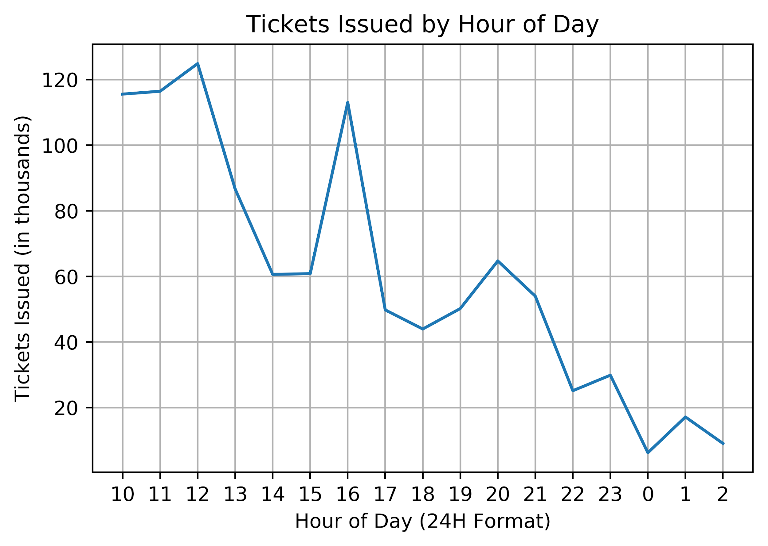
2018 Parking Trends by Hour of Day
In our dataset, 277,365 tickets were issued with a timestamp of 00:000. Those records were removed in this visual, which represents 78.75% of the total data set.
There are no data points from 2:00 AM - 10:00 AM - the chart shows our data starting at 10:00 AM through 2:00 AM.

Slide 10
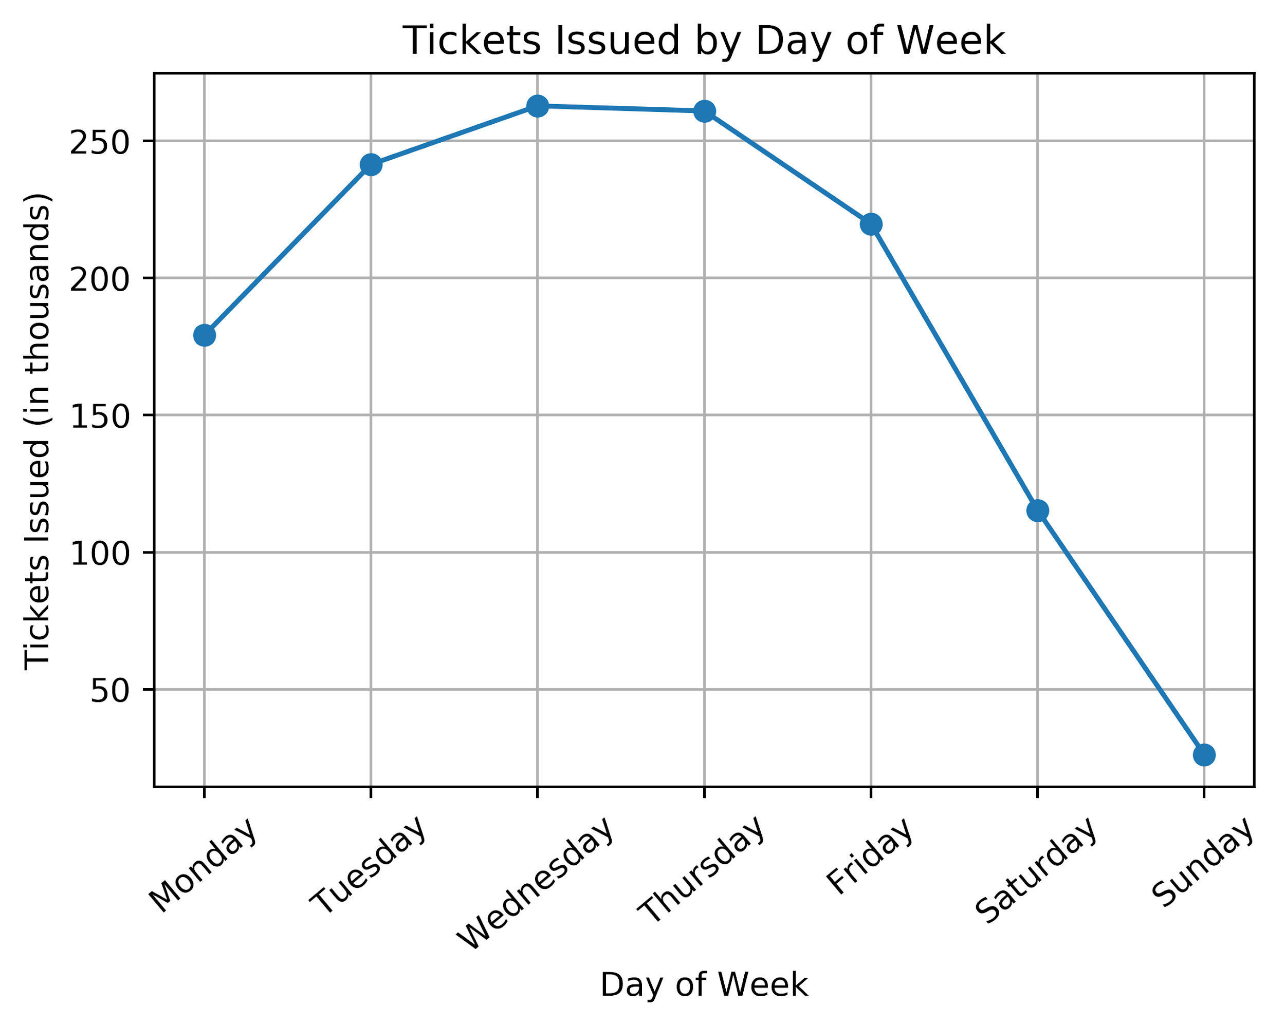
2018 Parking Trends by Day of Week

Slide 11
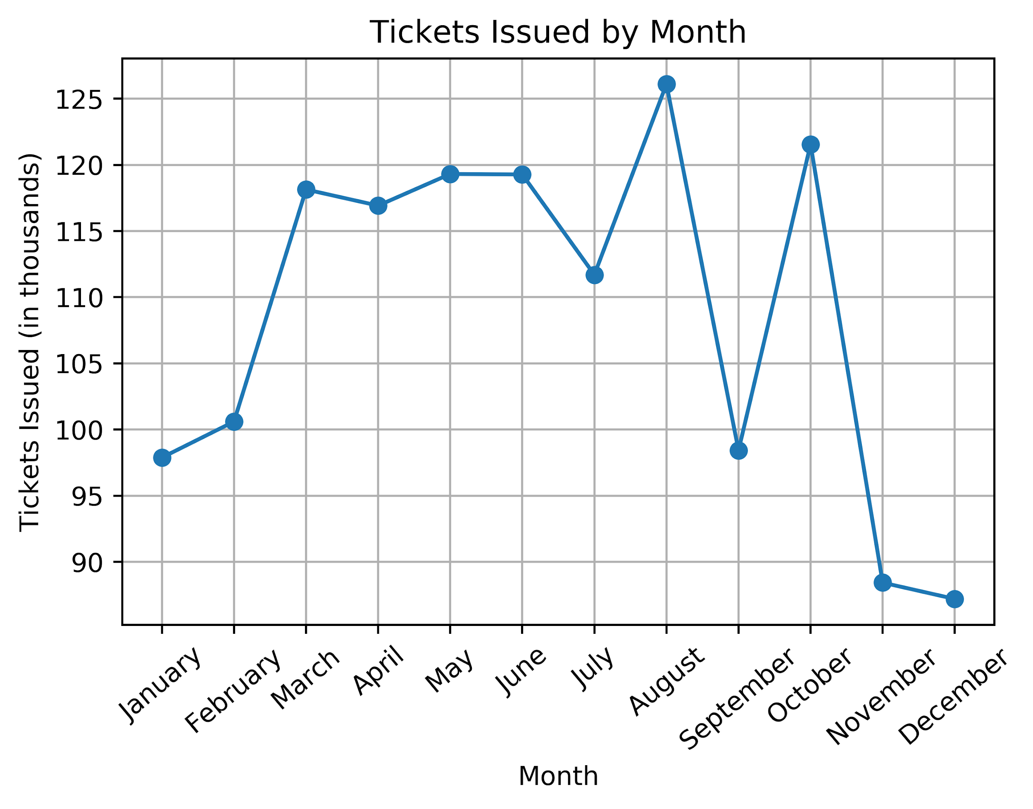
2018 Parking Trends by Month

Slide 12
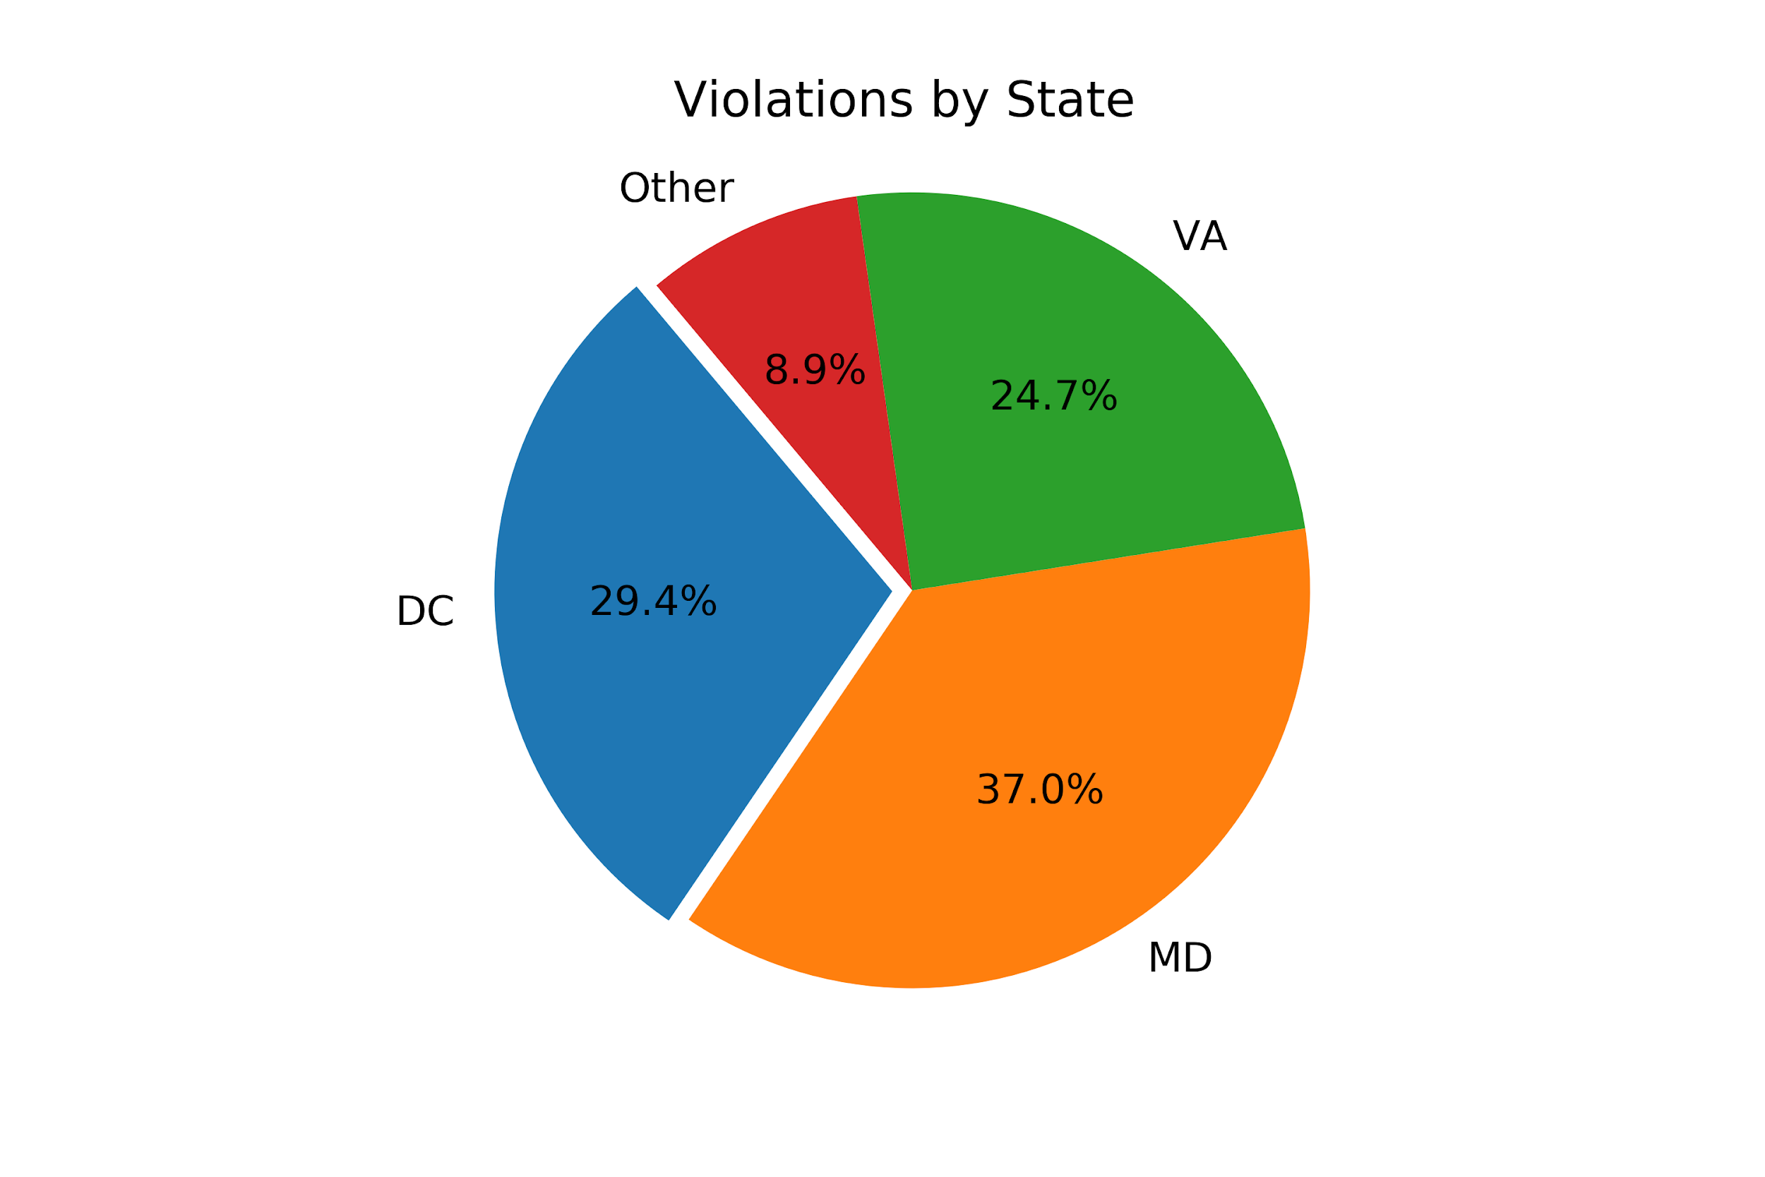
2018 Violations by State

Slide 13
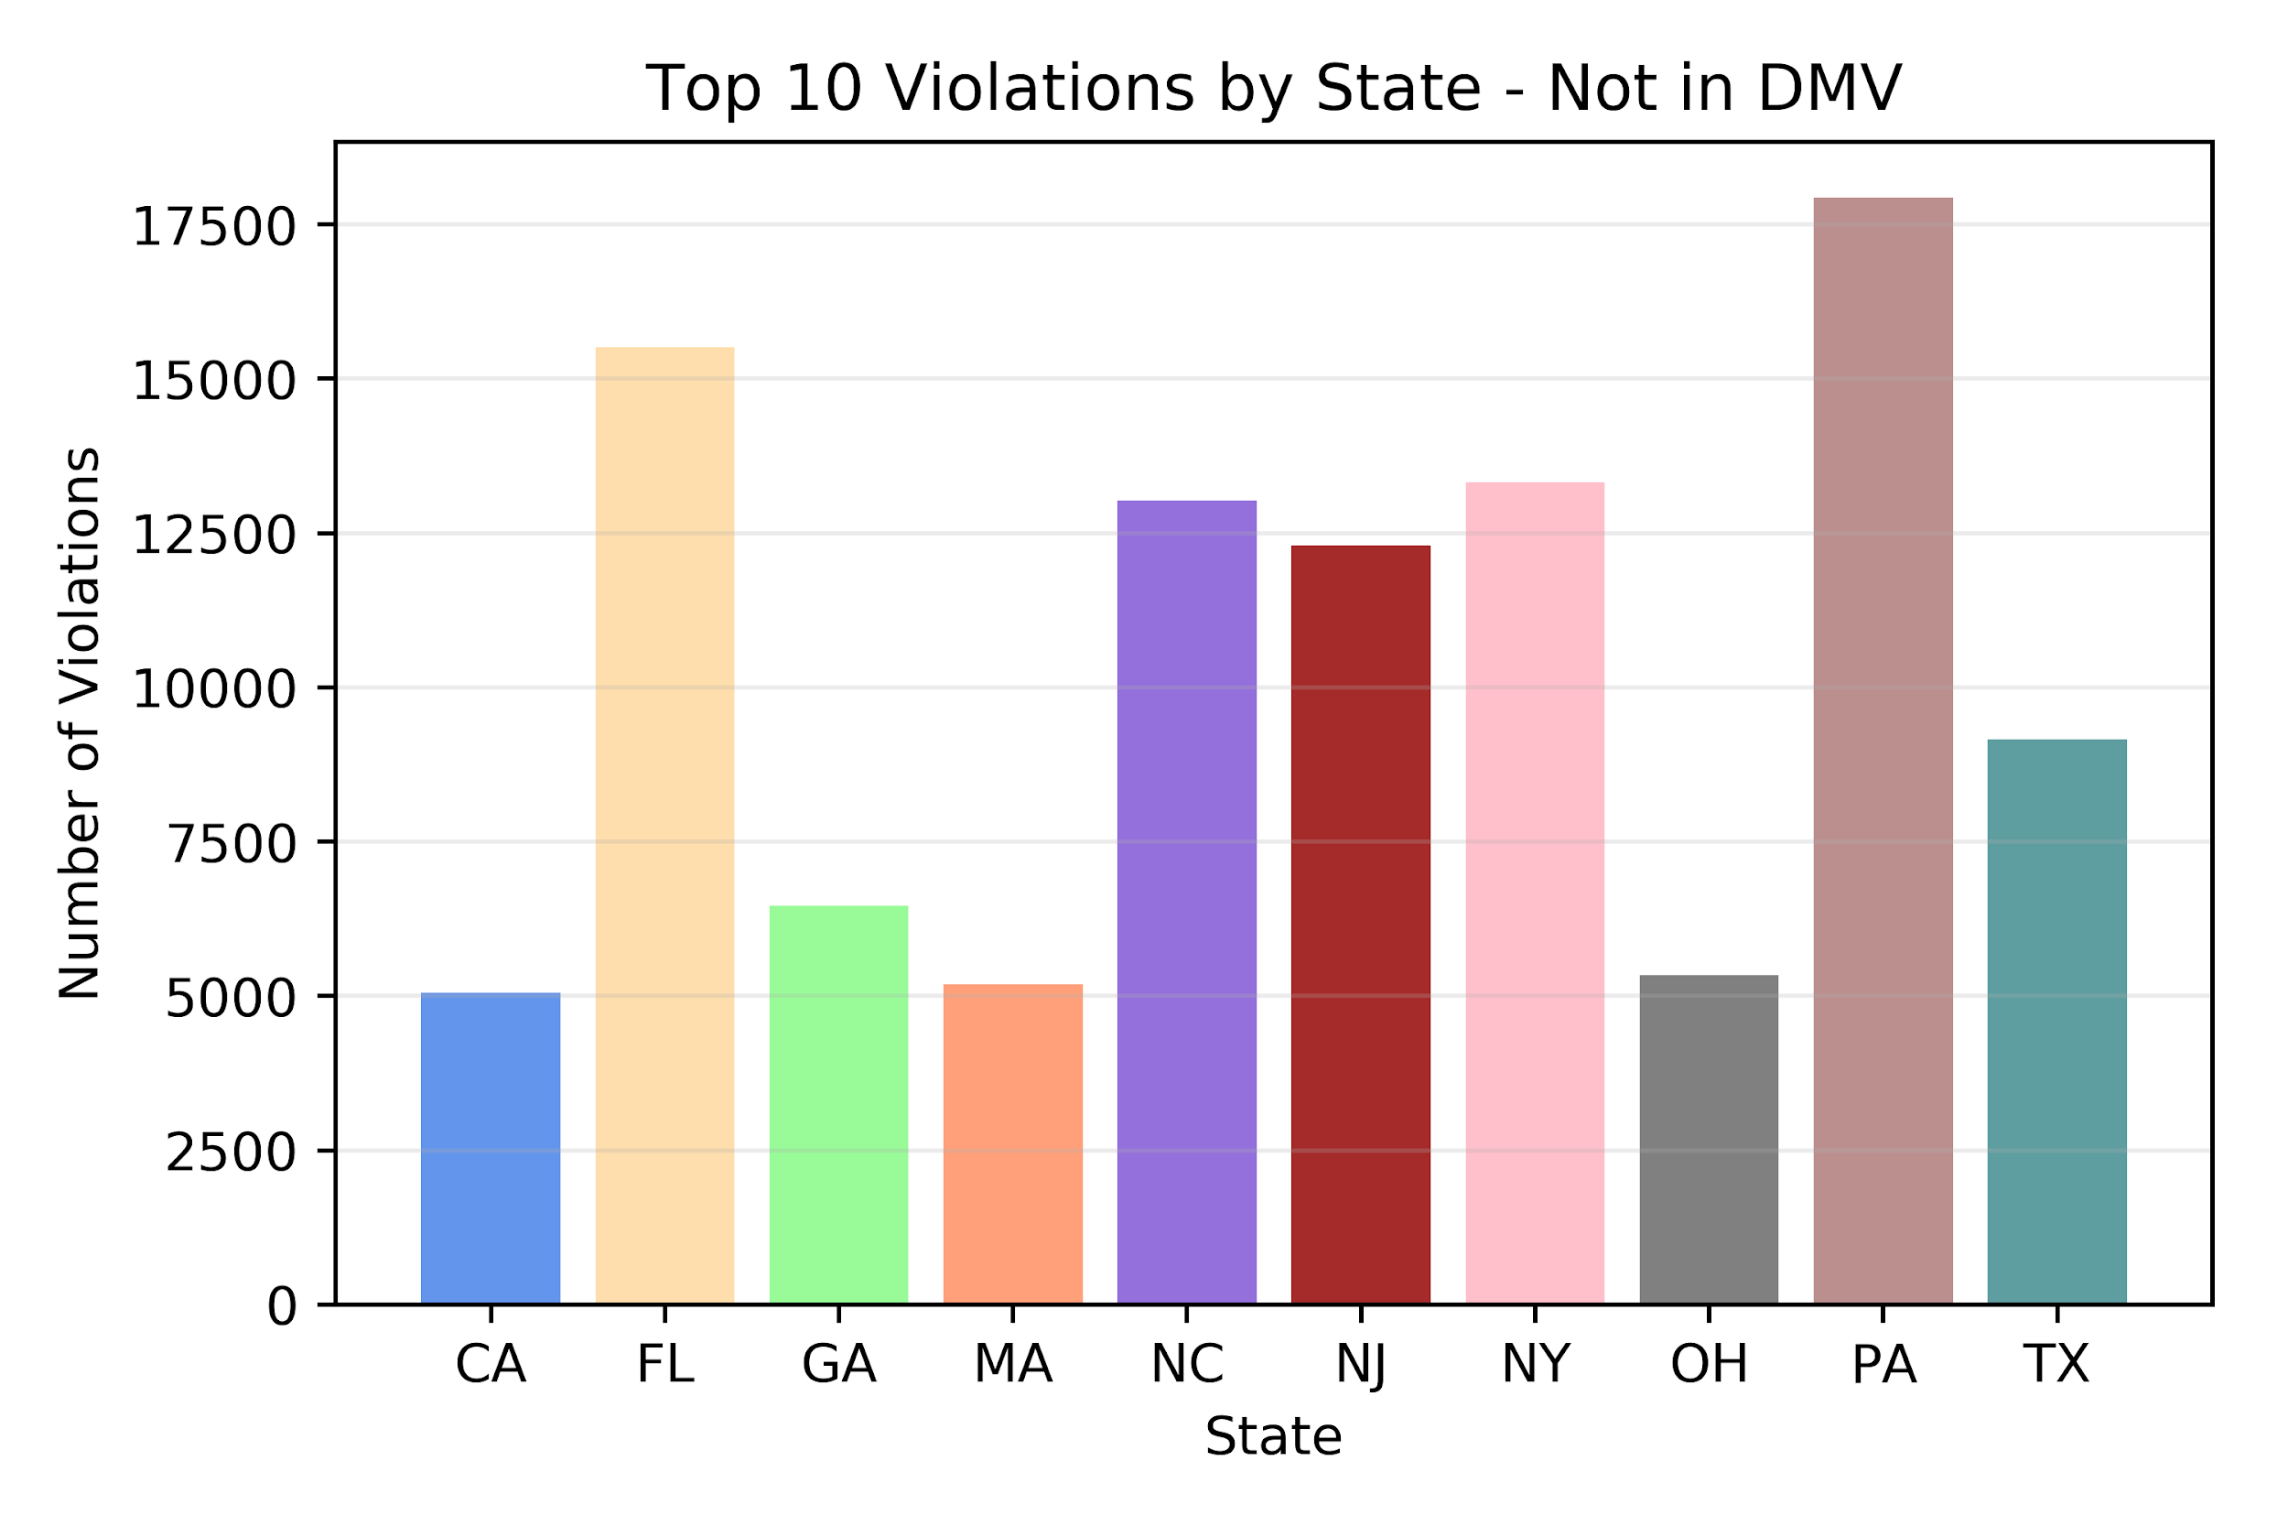
Violations by State Plate - Not in DMV

Slide 14
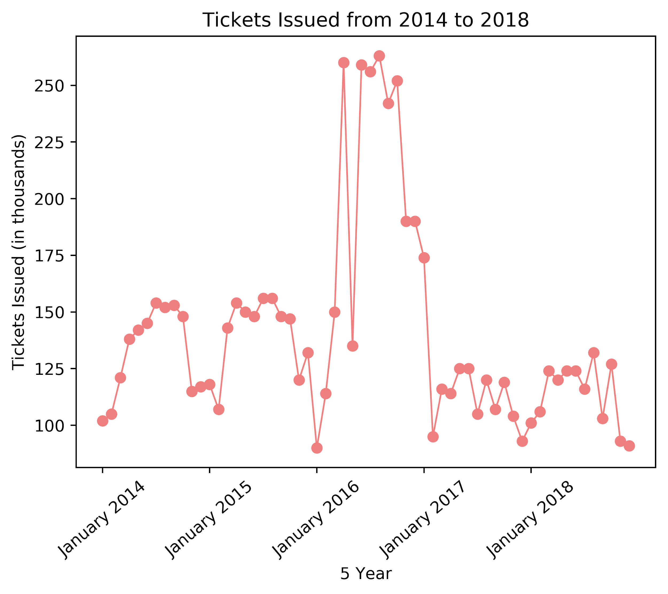
Trend by Year

Slide 15
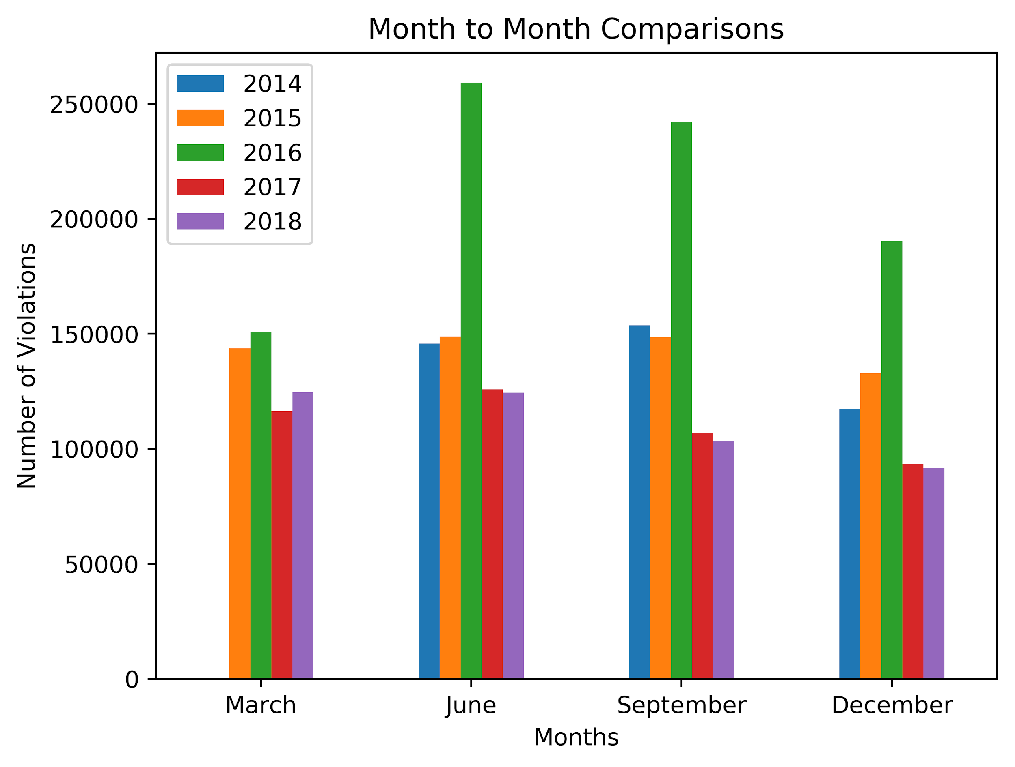
Sample month to month comparisons

Slide 16
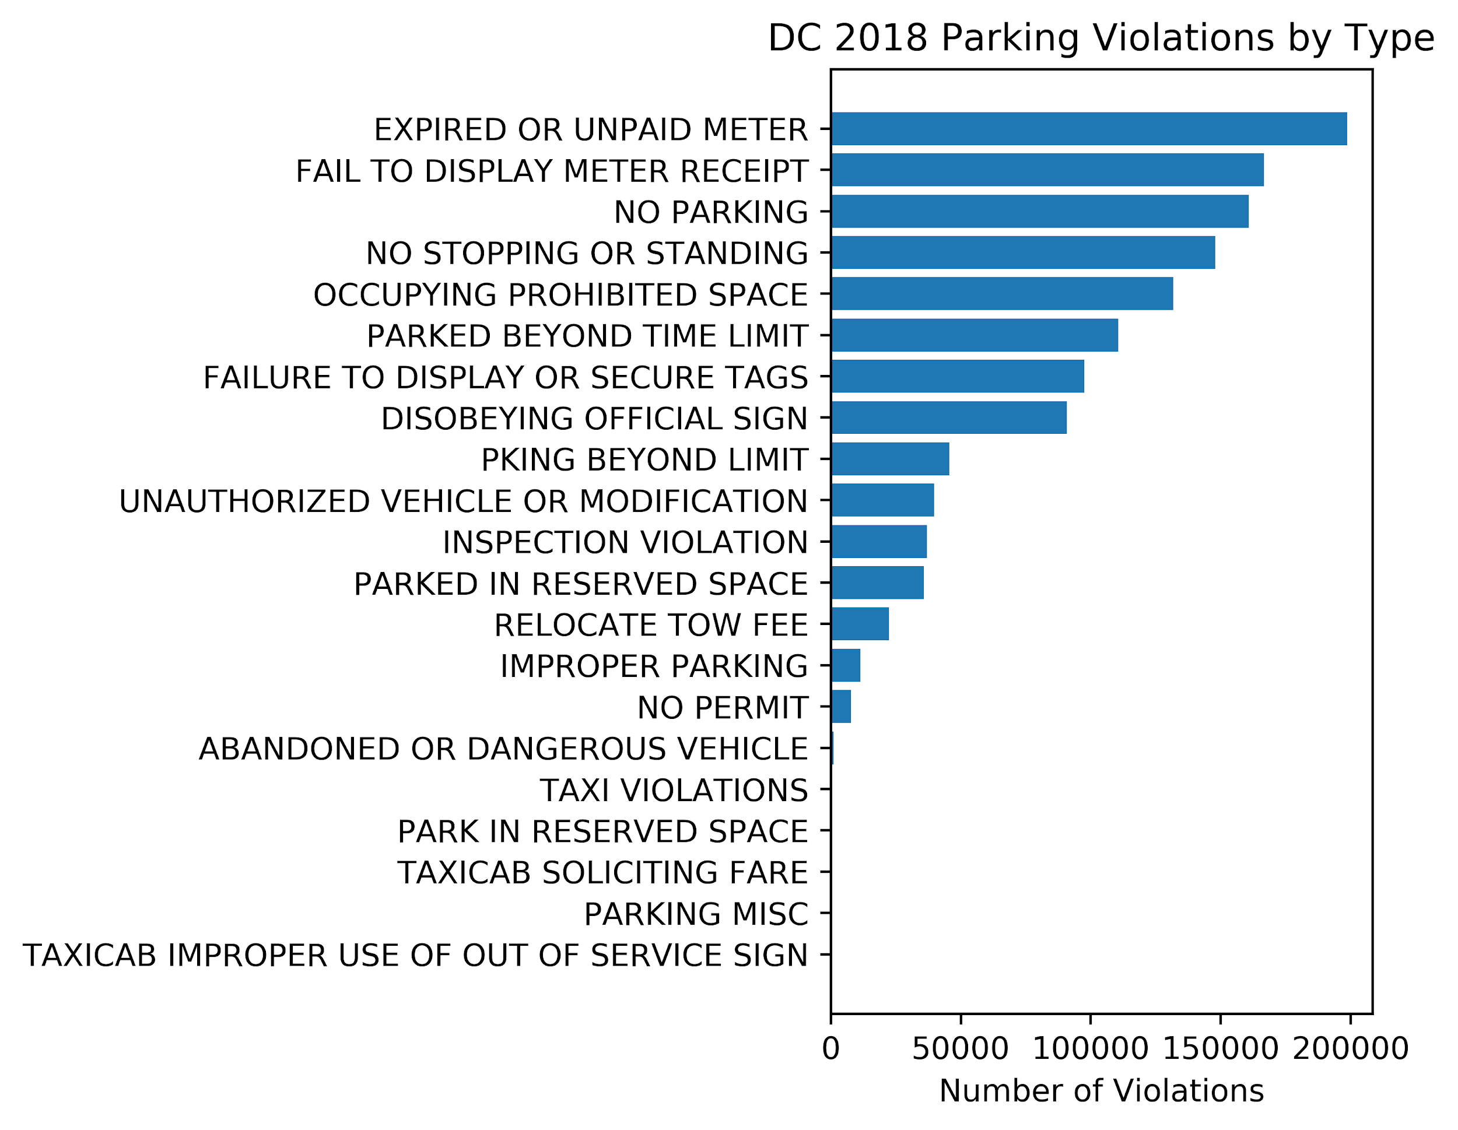
2018 Parking violation by type

Slide 17
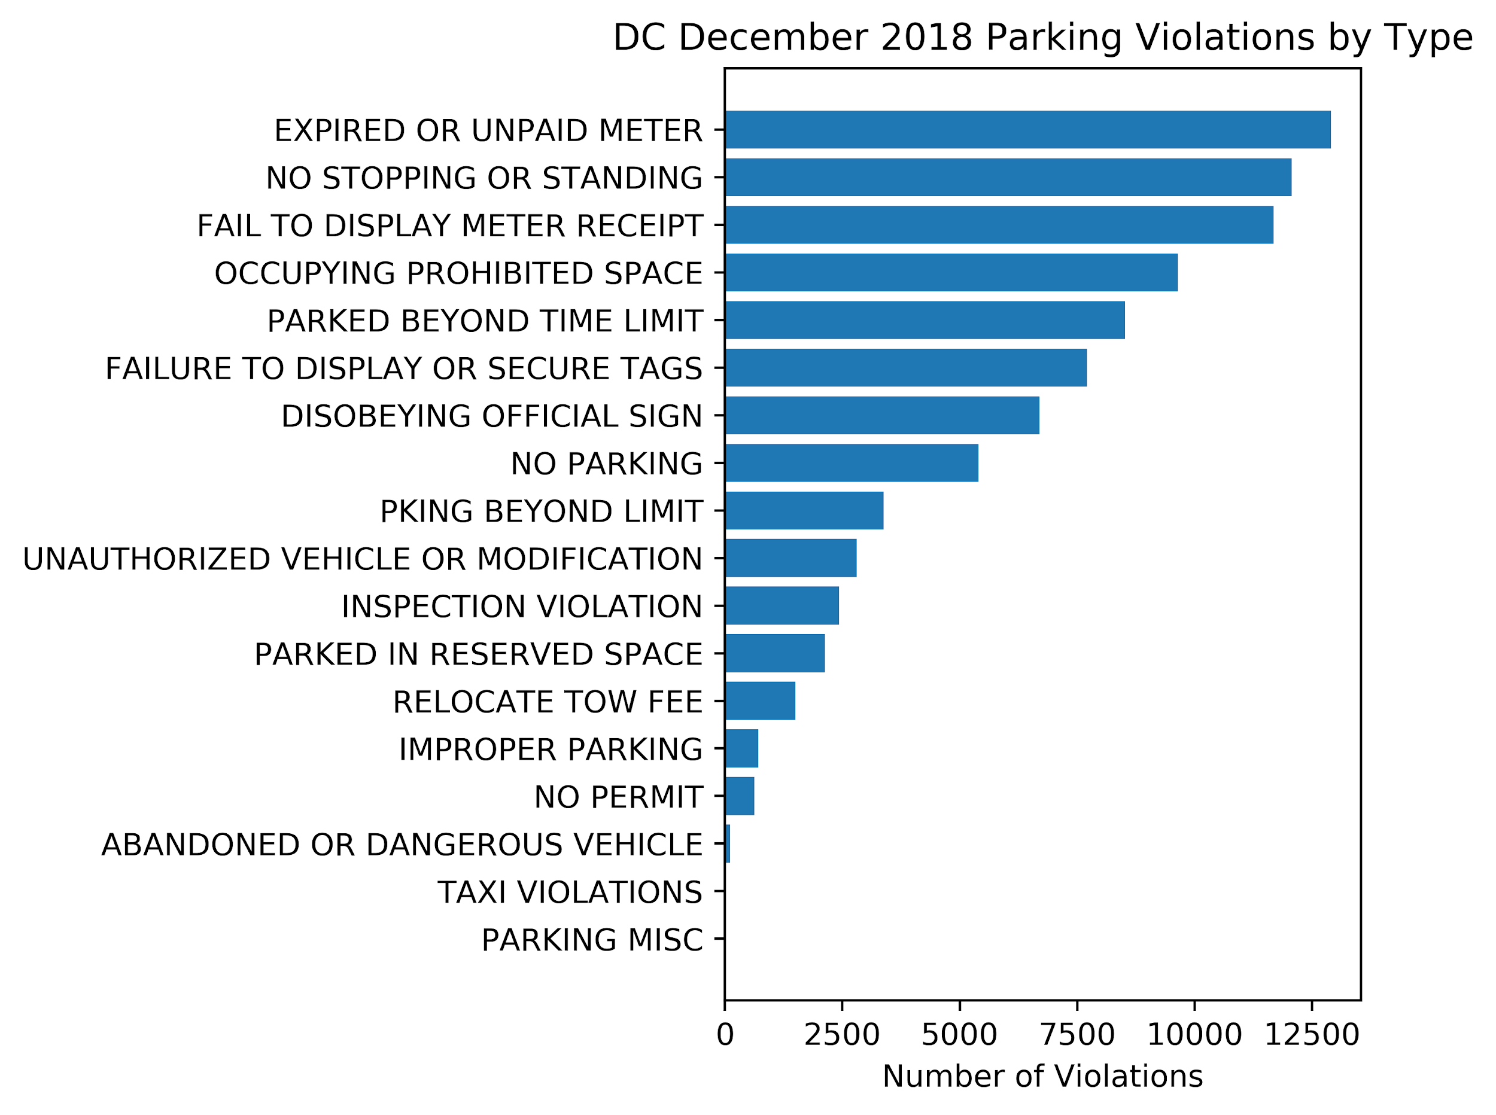
December 2018 tickets Issued by Type

Slide 18
Findings & Post Mortem

Slide 19
Limitations
Lacked budget data to see revenue from parking fines - WTOP had 2 articles, one of which referenced the data but did not include a source, and the other said the data was accessible through a Freedom Of Information Act (FOIA) request
Unsure of cause of tickets without a recorded time stamp
Not able to translate all state abbreviations (“MM”, “XX”, ‘YY”) to a state
Could not translate coordinates to zip codes to compare against census data

Slide 20
Further Questions
Fiscal year vs. calendar year
Adjudicated tickets
Repeat offenders

